Slide 1
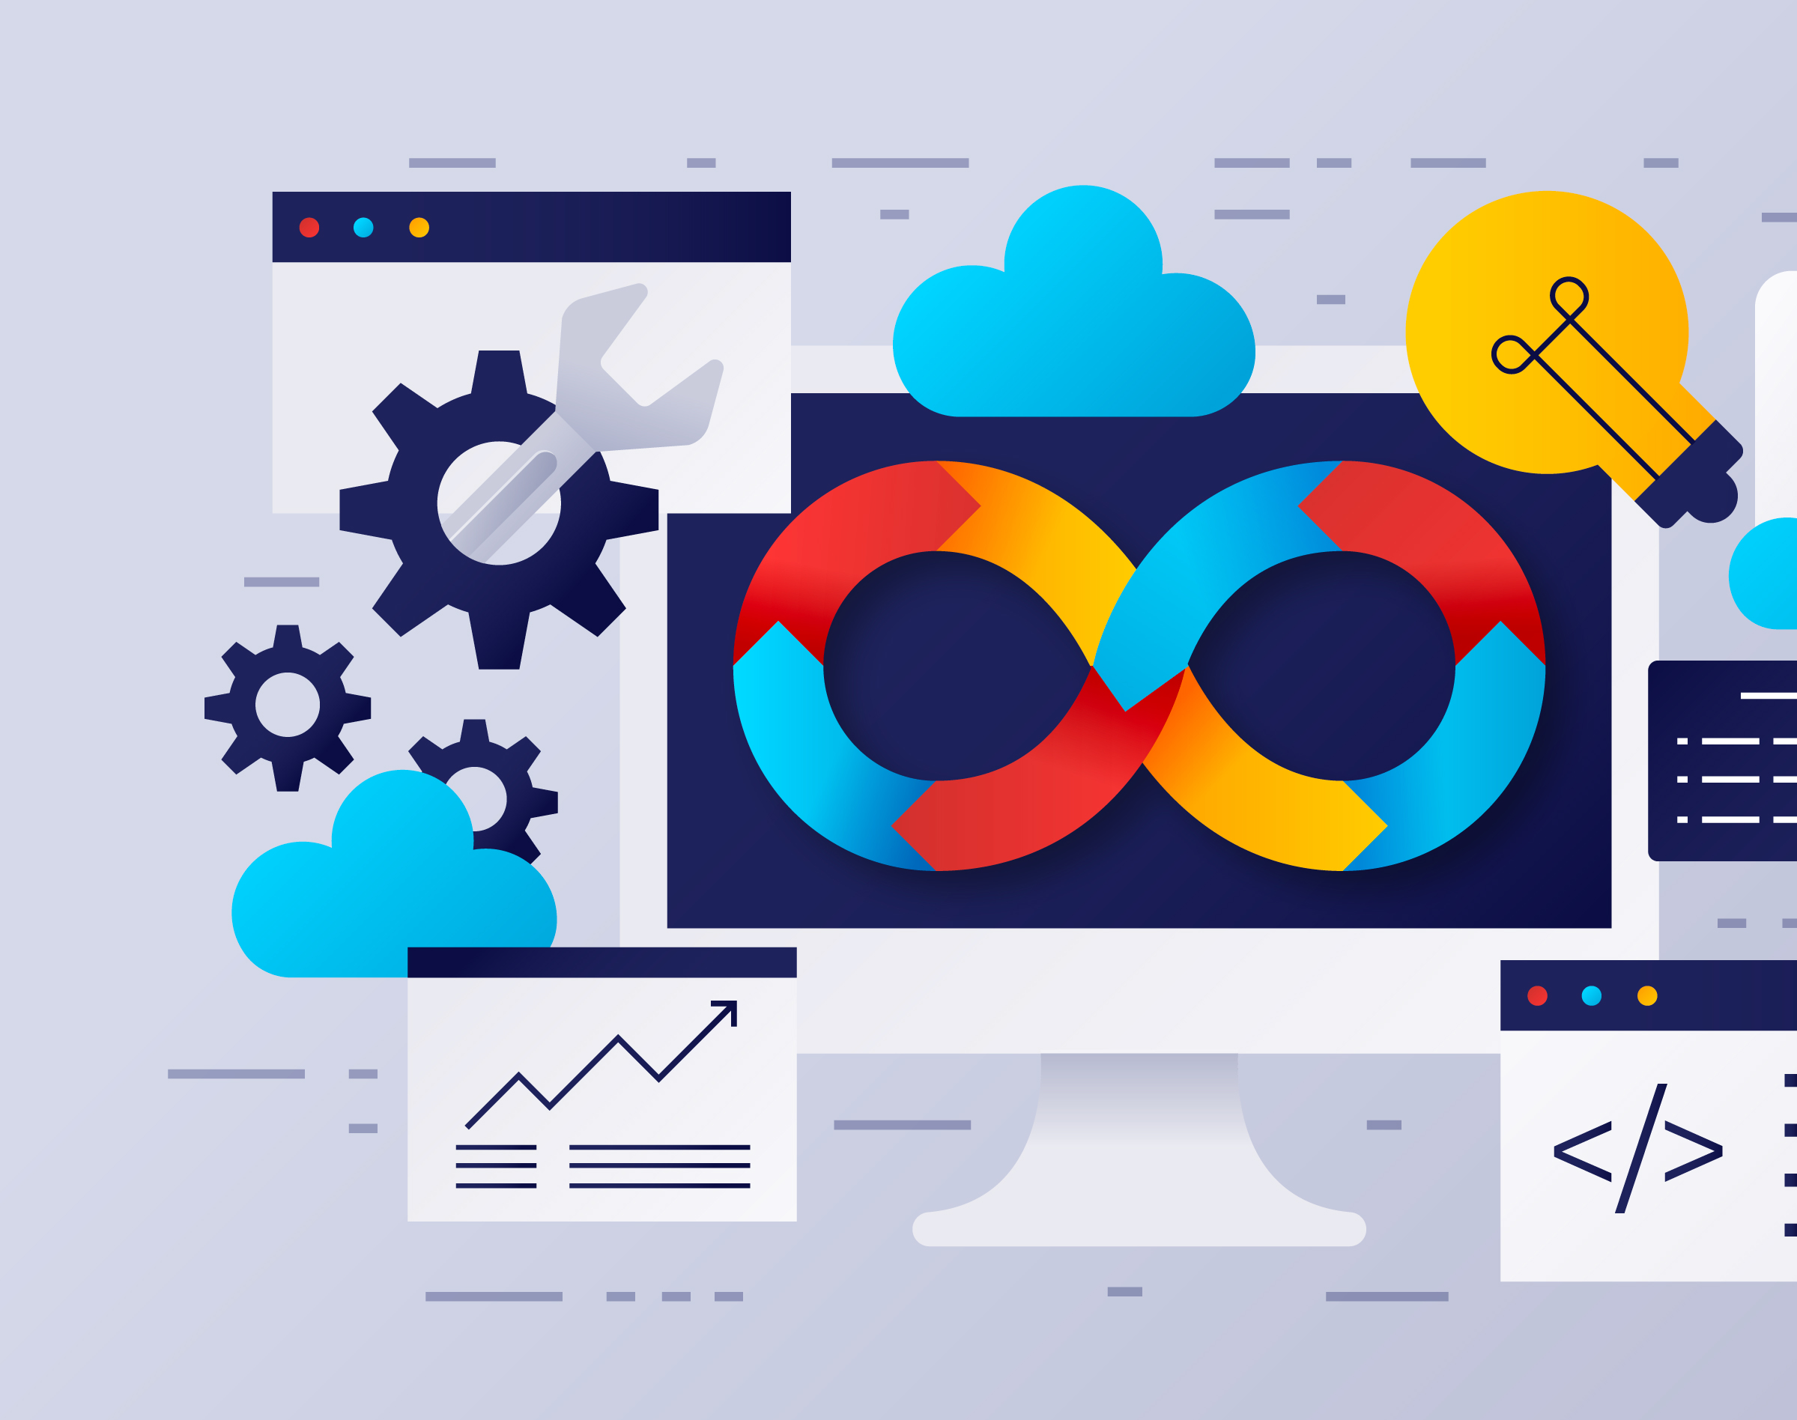
Module 1.2 Assignment Technology Value Steam
Exploring Lead Times and DevOps Efficiency
Written by Victor Gregory
CSD380-H330
Professor Sue Sampson

Slide 2
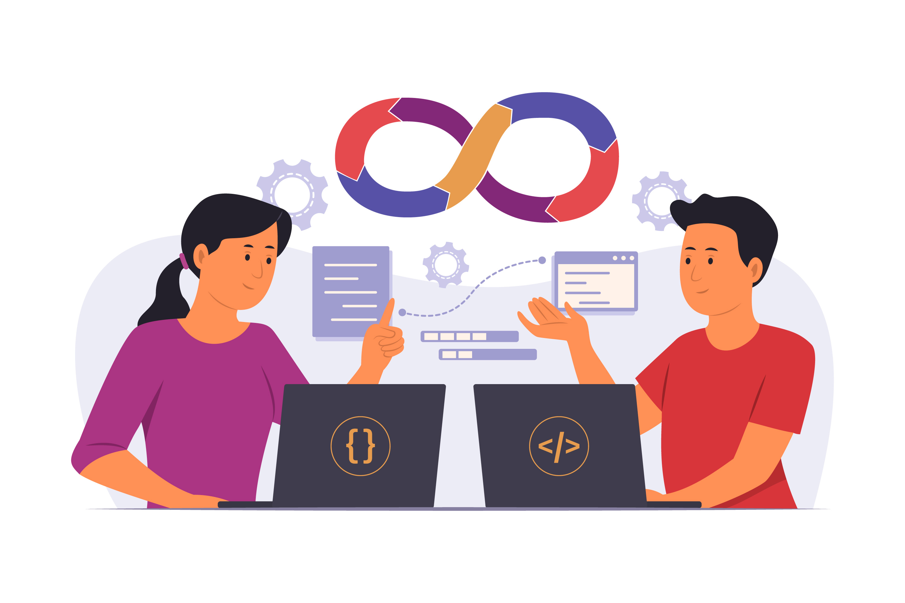
Lead Time vs. Processing Time
Lead Time: The total time from when a customer request is made until it is fulfilled.
Processing Time: The active time spent working on that request without including delays.

Slide 3
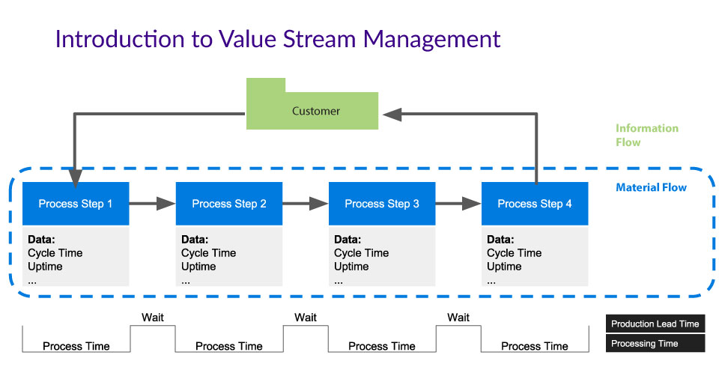
Lead Time vs. Processing Time
Key Difference: Lead Time includes waiting periods, while Processing Time focuses only on active effort.
In this Example: This graphic provides a timeline that helps to visualize the waiting and processing phases.

Slide 4

Traditional Deployment: Long Lead Times
Challenges:
Manual approvals can create bottlenecks.
Testing is often delayed until the end of development.
Limited communication between development and operations teams.
Consequences:
Slow innovation cycles and high operational costs.
Long deployment times affect customer satisfaction.

Slide 5

DevOps Ideal: Faster Deployment
Key Practices:
Continuous Integration and Continuous Deployment (CI/CD) automates code testing and delivery.
Automated testing ensures faster, consistent quality checks.
Enhanced collaboration between Dev and Ops improves efficiency.
Results:
Deployment times reduced from months to minutes.
Improved system reliability and faster feature releases.

Slide 6
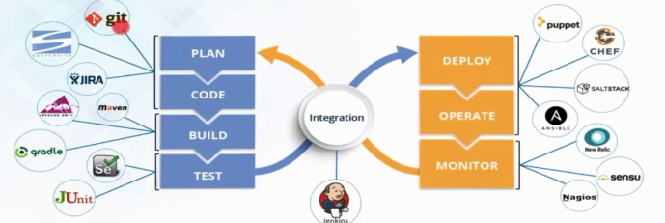
Before and After Deployment

Slide 7

Strategies for DevOps Success
Adopt CI/CD Pipelines: Automate testing and code integration.
Automate Infrastructure: Use Infrastructure as Code (IaC) for consistent environments.
Encourage Cultural Change: Foster collaboration between development and operations teams.
Track Metrics: Measure lead time, deployment frequency, and system reliability to drive improvement.

Slide 8

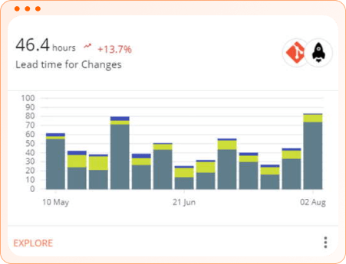
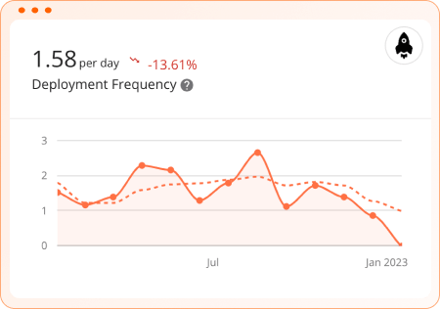
Case Study: DevOps in Action
Company: MeCo
Challenge: Deployment times took months due to manual approvals and disconnected teams.
Solution: Implemented CI/CD pipelines, automated testing, and streamlined communication between teams.
Results:
Deployment lead times reduced from 3 months to 15 minutes.
Improved system reliability and faster delivery of customer features.

Slide 9

Conclusion
Traditional methods result in long deployment times and inefficiencies.
DevOps practices enable faster, more reliable software deployment.
Takeaway: Streamlining the technology value stream improves both efficiency and customer satisfaction.

